Slide 1
Data Analyst Assignment
TekFriday

Slide 2
Introduction
My Name is Sreenivas Dasappagari.
An Undergraduate Student in the stream of Computer Science and Engineering. Completed All Semesters with 7.2 CGPA.
I was Professionally focused on Data Analyst for that I have gained Theoretical and Practical Knowledge by doing Internships and Exploring Domain Technologies.
To Fulfill my Professional Goal, I’ve Gained Knowledge and Programming work in the languages like Python, SQL.
To Balance Practical Work learned working with tools& like MS Excel, My SQL, VS Code. And also learned Automation tools for Data Analysis like Alteryx Designer, Qlik Sense, Power BI.
I have done 2 months Internship as Business Analyst Where I have done a mini project about Road Safety Patterns in India. During Internship I gained Practical Experience working with Qlik Sense.
Also, I have been trained on 2 months internship with EduSkills Organization on Data Analytics Process Automation. Which helps to learn and Earn certificate of Alteryx Designer Core.

Slide 3
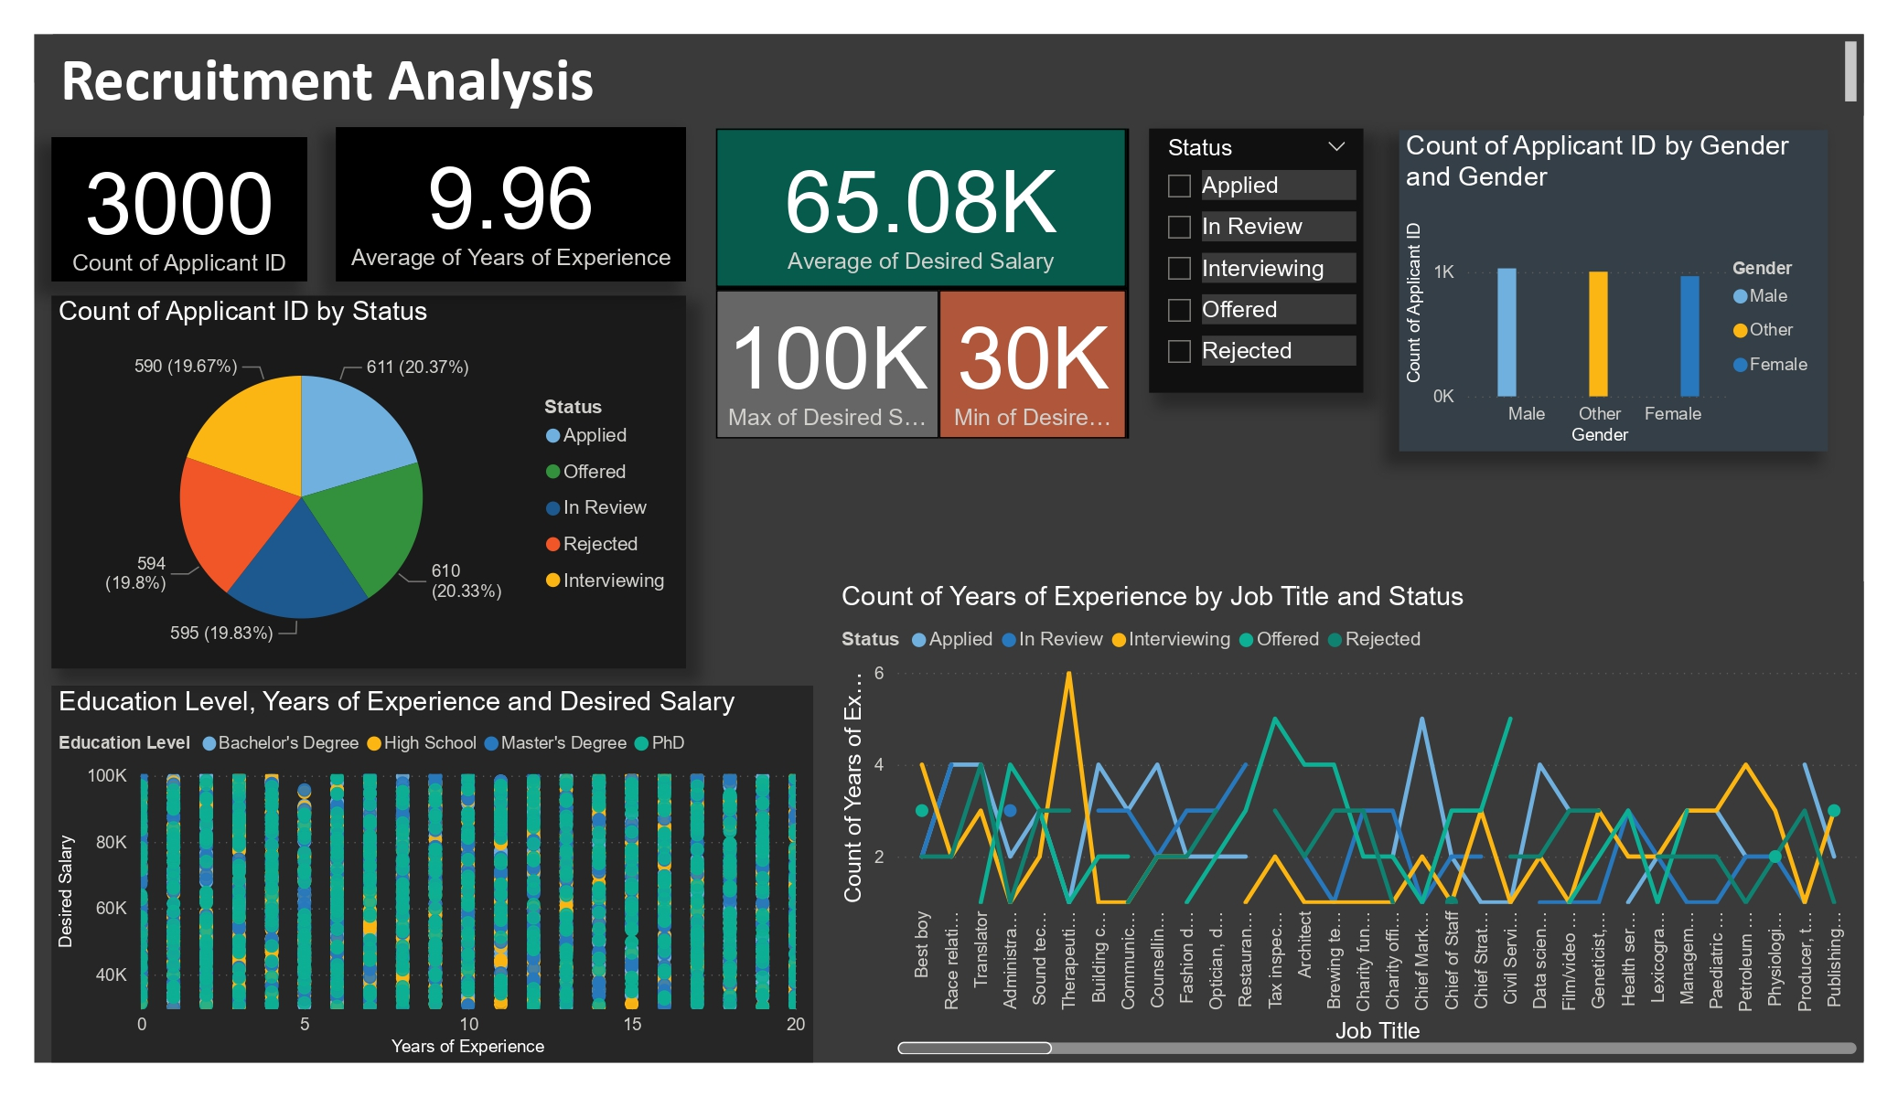
Recruitment Analysis Dashboard

Slide 4
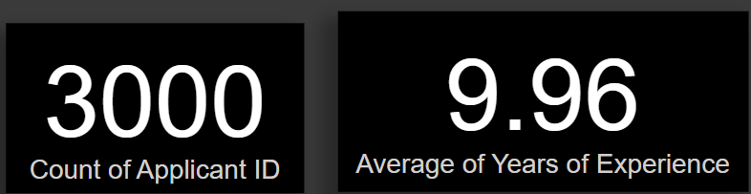
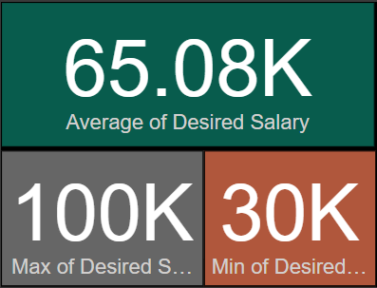
Recruitment Analysis
Introduction:
The Recruitment Dataset is a data of Job Applicants. Provides a detailed overview of hiring process with the information of applicants with the key components like Applicant Details, Job Role, Salary Expectations, Application Status, Experience.
Visualizations:
The cards shows the overall count of applicants and Average years of experience. To negotiate the requirement of applicants for right role
And we can also see the multi card which shows the average salary with maximum and minimum desired salary. Helps to navigate the salary expectations.

Slide 5
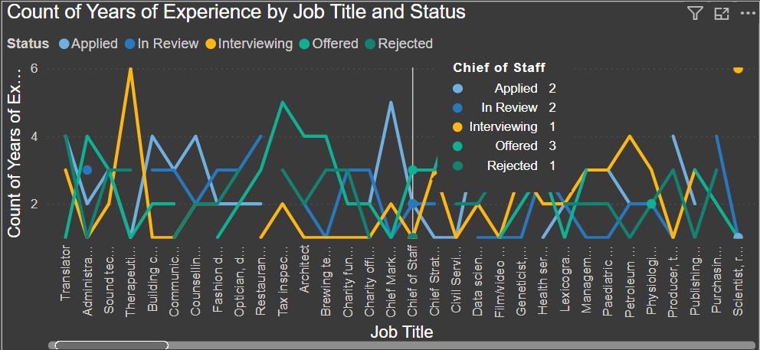
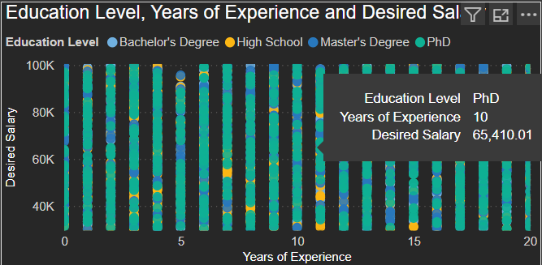
The line chart shows the status of applicants with their job titles including their year of experience. Which helps to figure out the status of applicant for particular job role with their experience level.
The scatter plot chart shows the Education qualification, Experience and their desired salary. To know the salary expectations based on years of experience and qualification.

Slide 6
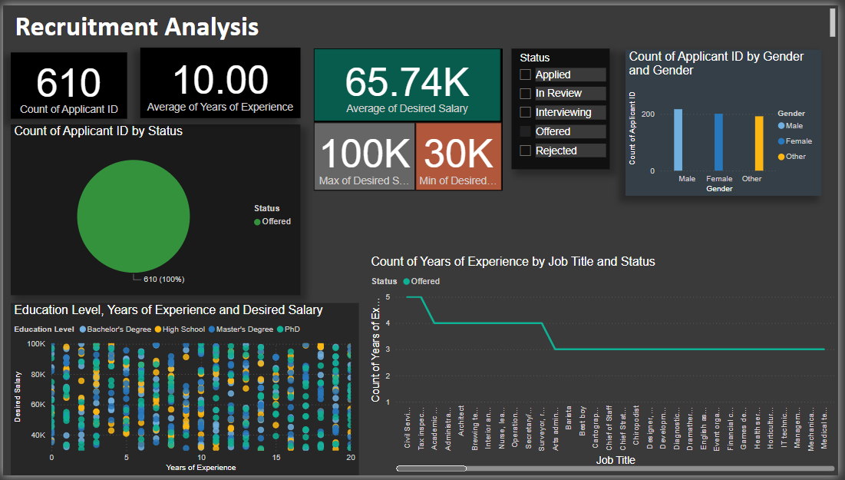
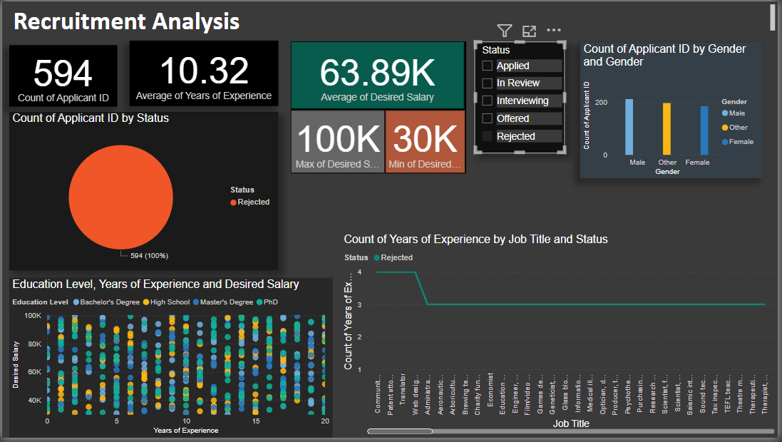
Dashboard overview
Dashboard Slicer:
Using Slicer to apply the status filter to quickly get the needed results in the visualizations. Where we can easily get the result of recruitment outcome through all key components. Following both figures shows the result of Offered and rejected Applicants through the quick filters.

Slide 7
Insights and Key Findings
Insights:
The mean is 9.96 years, indicating a fairly seasoned pool of applicants.
Average: $65.08K, Minimum: $30K, Maximum: $100K Indicating a broad salary expectation range indicates diverse applicant backgrounds.
Each status possesses approximately 20% of the applicants, reflecting a well-balanced recruitment process with no serious bottlenecks.
Job allocation were equitable by Gender. Wanted salary increases with experience years at all levels of education.
Master's and PhD graduates have higher expectations of their salary.
Key Findings:
The hiring pipeline is balanced.
There is experience, gender, and education diversity.
Salary expectations are extremely diverse, highlighting the importance of defensible compensation benchmarking.
Some types of job positions demand much greater experience, perhaps an indication of complexity or organizational demands.

Slide 8
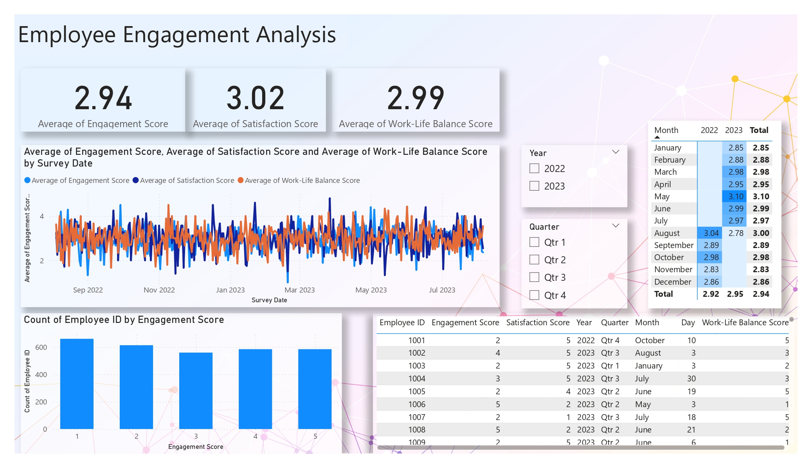
Employee Engagement Dashboard

Slide 9
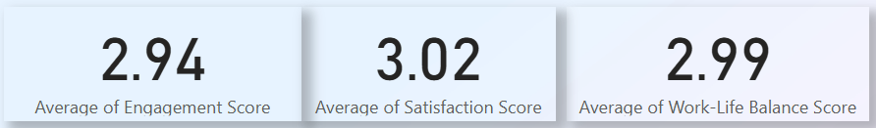
Employee Engagement Analysis
Introduction:
The Employee Engagement Dataset contains employee survey data. Which helps to know the feedback from employees with key aspects Engagement score, Satisfaction score, Work-life Balance score. The data helps analyze how employees perceive their work experience and emotional connection with their workplace.
Visualizations:
The cards shows the average of Engagement score, Satisfaction score, Work-Life Balance score. Which helps to know the average interaction and response from employees to maintain the workplace environment. Also they can Improve the Work-culture by above average ratings.

Slide 10
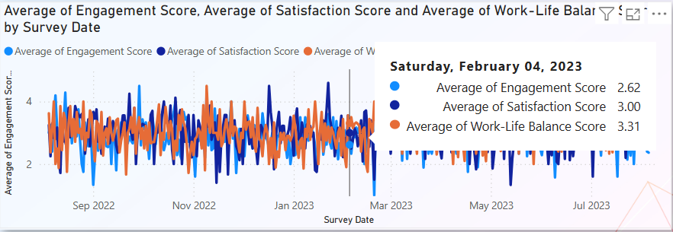
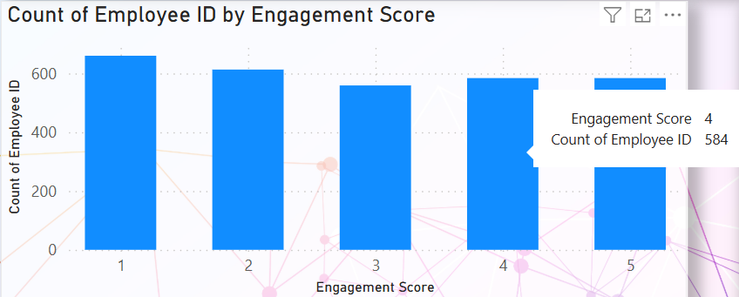
The line graph chart shows the Average of Engagement score, Satisfaction score, Work-Life Balance score with the survey conducted date. Which helps to filter out the scores by the particular survey date.
The Stacked bar chart shows the Particular Rating in engagement score by the number of employees. Which helps to measure the Engagement score easily. And we can also filter for both Satisfaction score and work life balance score too.

Slide 11
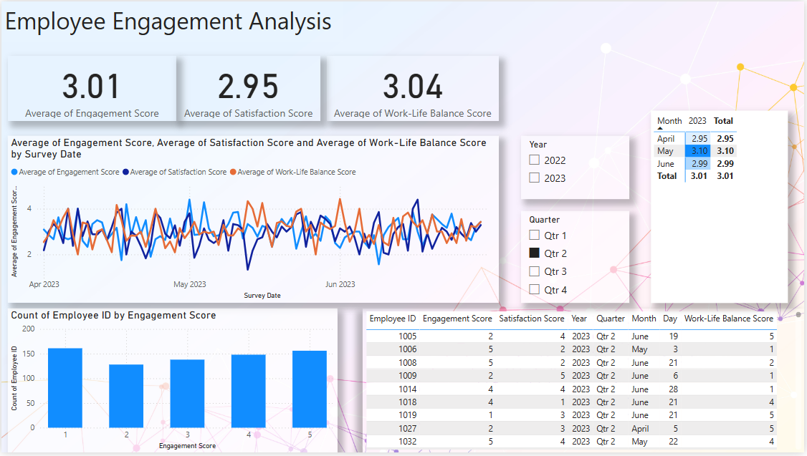
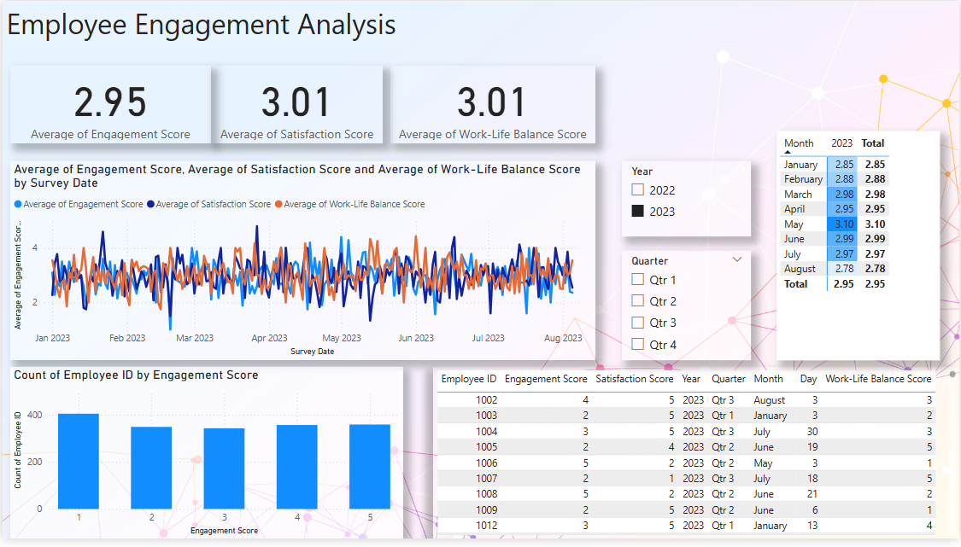
Dashboard overview
The slicer is used to apply quick filters to dashboard. Which helps to get the values and data from both table and matrix table as well as other visualizations also. Quarter Slicer has been used to get results of a Particular quarter .
The year slicer is used here to get yearly results and constraints in the Dashboard.

Slide 12
Insights and Key findings
Average Engagement Score: 2.94,Average Satisfaction Score: 3.02,Average Work-Life Balance Score: 2.99.
These numbers reflect a moderate employee engagement and satisfaction level.
May recorded the highest engagement score (3.10) during the period of observation.
February and November recorded the lowest scores (2.88 and 2.83, respectively).
Engagement levels have fluctuated minimally throughout the year.
A large majority of employees have lower engagement scores (1 to 3), reflecting areas for improvement in workplace initiatives.
Employee count marginally reduces as engagement scores rise.
Survey scores are quite stable month by month, without spikes or dramatic falls, and indicate a stable engagement climate with little volatility.
The quarterly filters enable targeted review for any quarterly or seasonal trends.
Approximately 2.5K employees took part in the survey, demonstrating high participation in the engagement process.

Slide 13
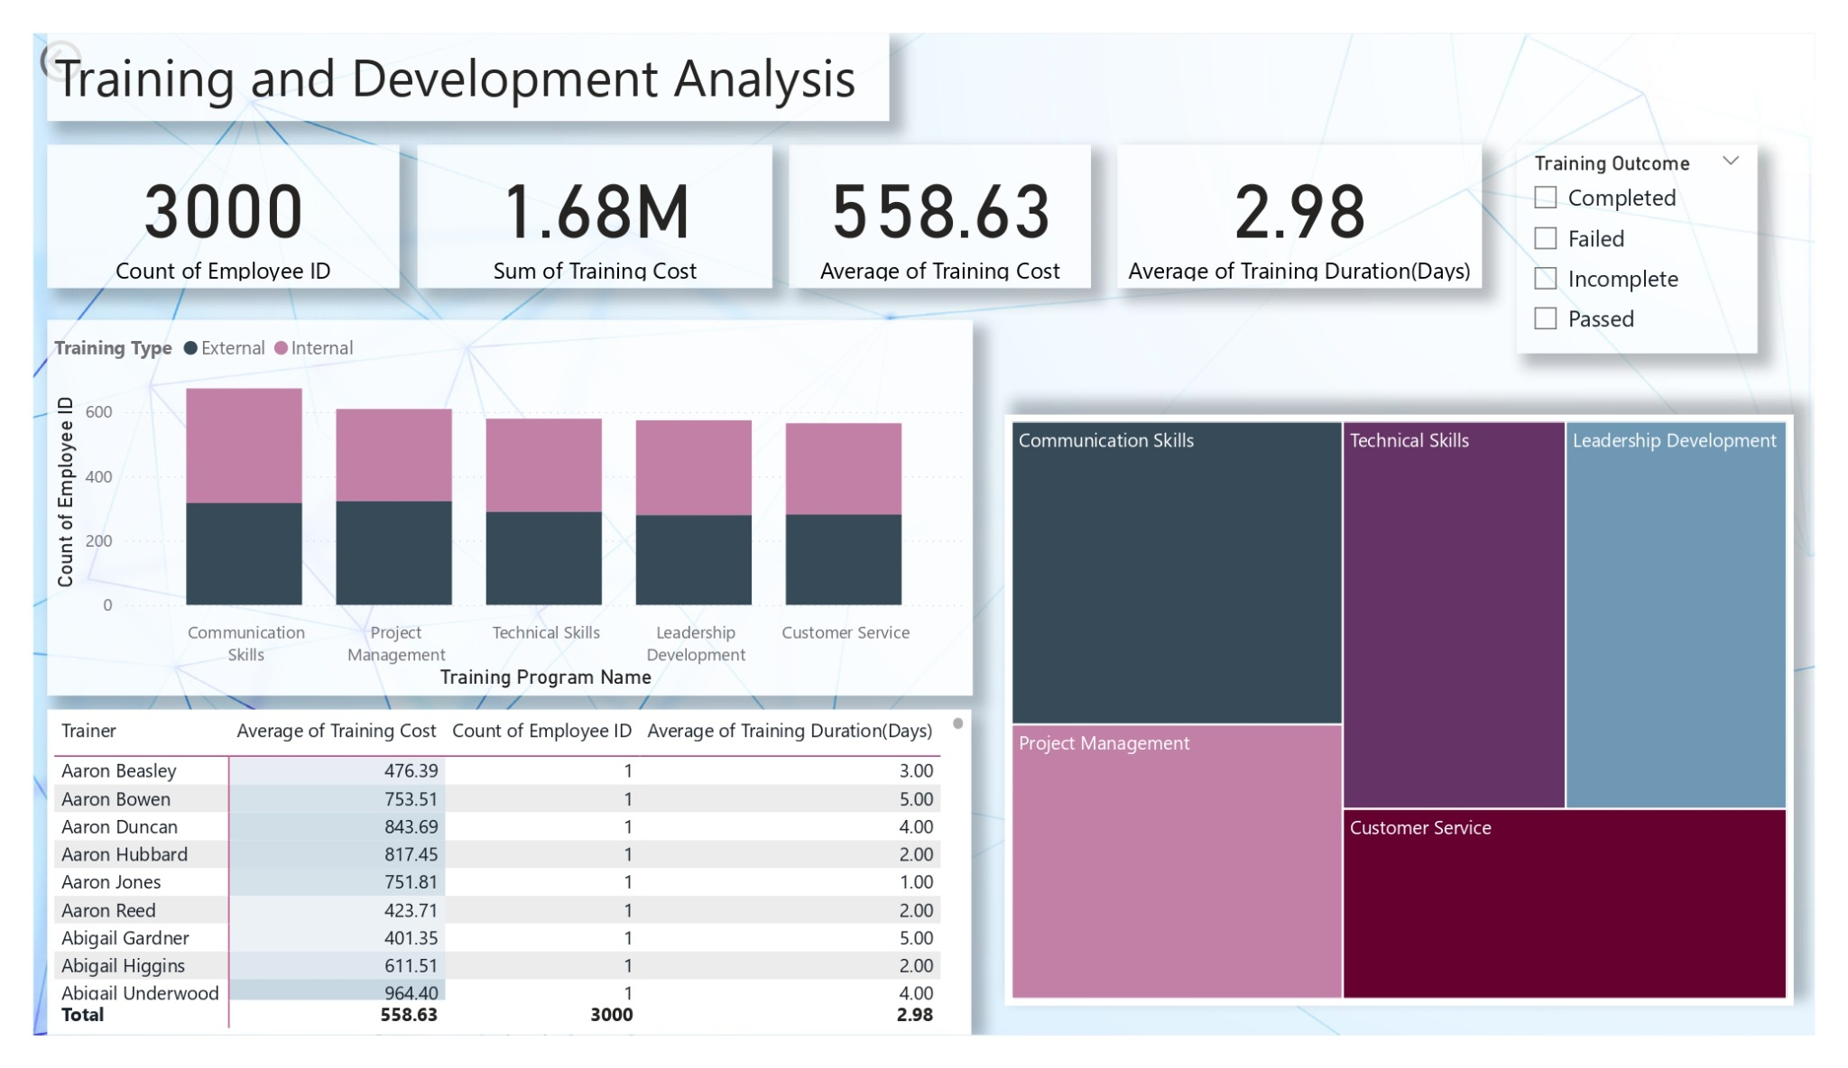
Training and Development Dashboard

Slide 14
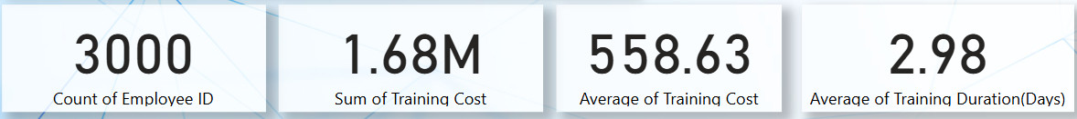
Training and Development Analysis
Introduction:
The Training and Development Dataset Shows the data of essential training program and development activities in an Organization. Which showcase the result of training with desired skills. The data contains the information of training with key components Employee IDs, Types of training programs, Training duration, Training cost per participant, Training outcomes, Type of training Trainer details.
Visualization:
The above cards shows the count of Employees, Total Training cost, Average training cost per person, average training duration days per person and a trainer. It shows the values of training activities. Which helps to estimate the cost, duration per employees and cost of investing.

Slide 15
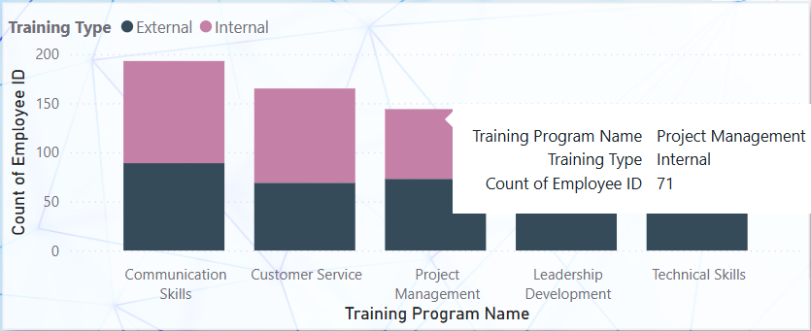
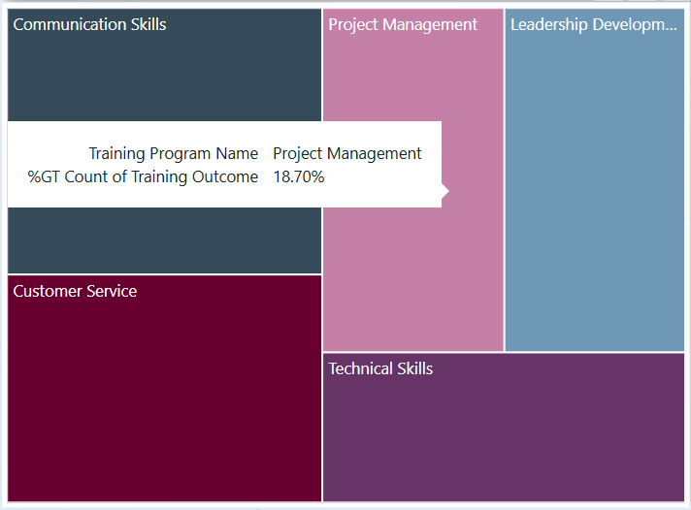
The stacked bar chart shows the count of employees interacting with different type of training programs including the training type which means internal or external. It helps to navigate the program attendees count with both internal and external.
As of now we count the attendees through the internal and external type. Now this tree map shows the percentage of outcome through the training period. Which helps to navigate percentage of attendees in different programs.

Slide 16
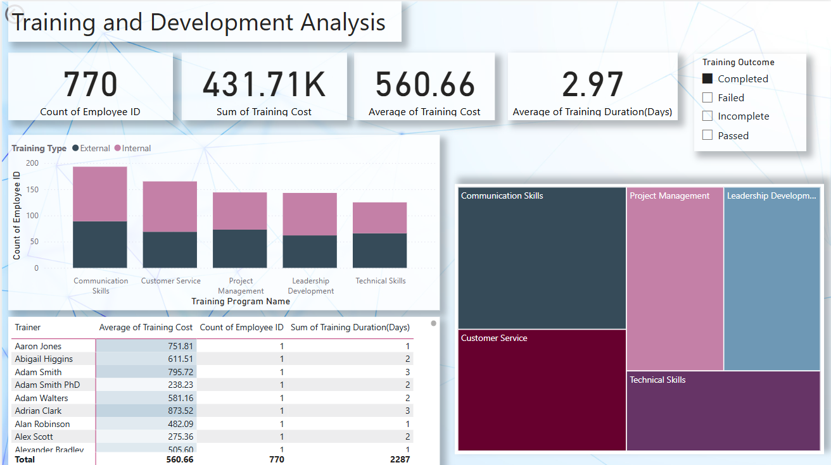
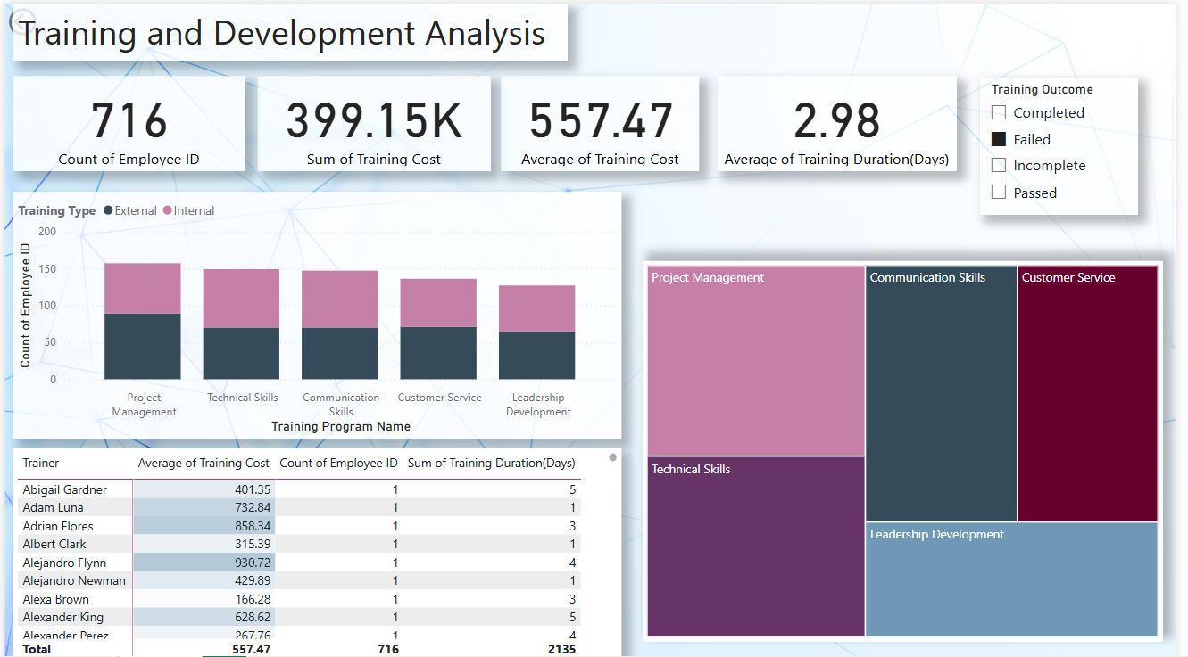
Dashboard Overview
The Slicer is used to filter the overall dashboard outcomes primarily focused on matrix table to filter the Completed outcome of training. This helps to navigate the outcome by certain section and get the acknowledgement from different aspects like training cost, Duration, Training type, etc.
Before we used Completed in the slice. Now we are using Failed in slicer to filter the candidates which are failed to attend the training. Helps to filter the candidates during hiring process.

Slide 17
Insights and Key Findings
Over 3,000 employees participated in a variety of training sessions, most of which were short, 3-day programs aimed at delivering quick, impactful learning. The company invested significantly—averaging around 559 per person, with a total spend nearing 1.7 million.
The most popular sessions focused on Communication and Technical Skills, showing an emphasis on both interpersonal and practical capabilities. Programs like Project Management and Leadership Development also saw strong interest, highlighting a clear focus on preparing future leaders.
Training was a mix of internal and external formats, indicating a balanced use of in-house experts and outside professionals. Most employees completed or passed their training, with only a few not finishing—this speaks to the quality and relevance of the programs offered.
Trainer performance varied: for example, Aaron Beasley delivered cost-effective sessions, while Aaron Duncan's trainings were longer and more expensive, offering room to review efficiency.
Key Findings:
The organization is investing significantly in employee development across technical, managerial, and soft skills.
Short-term, high-impact training formats are preferred.
There is a strong completion and success rate, indicating quality content and engaged learners.

Slide 18
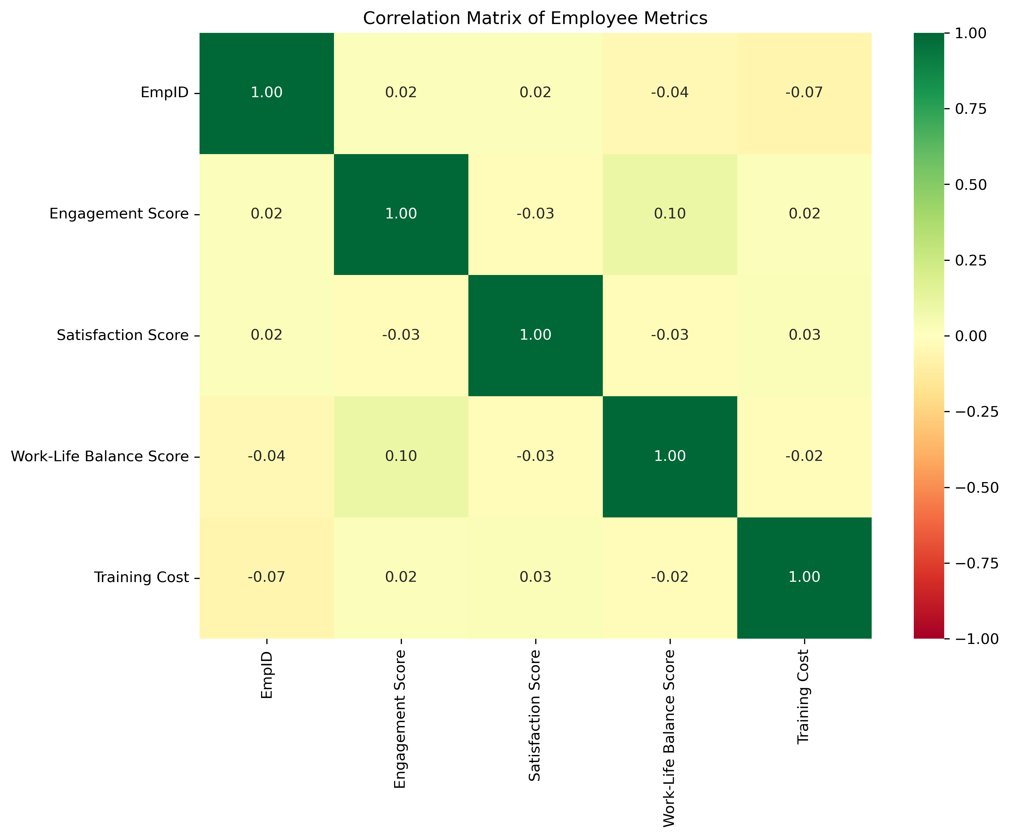
Correlation Metrices Heatmap

Slide 19
Correlation Metrices
Introduction:
Correlation helps us understand how two metrics move together. for instance, whether higher training investment leads to better employee engagement. A correlation value close to 1 means a strong positive relationship, while one close to -1 signals a strong negative relationship. Zero means no relationship.
Key Findings:
There were no strong relationships, which shows employee behavior is complex .No single metric drives the others.
There was a mild positive link between work-life balance and engagement. which supports what we saw in the dashboard. As well as in correlation.
Training cost, interestingly, had little effect on other outcomes. Thoughtfully how we design and deliver training is more important than how much we spend.
The low correlation values overall highlight that employee outcomes are influenced by multiple diverse factors, not just one.

Slide 20
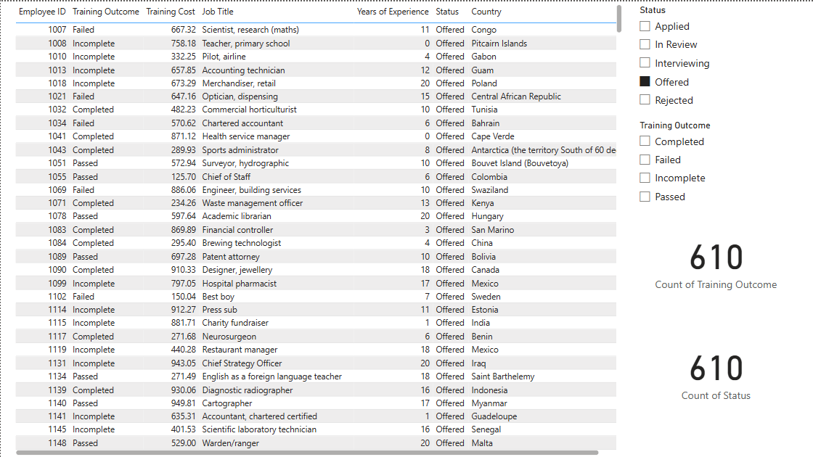
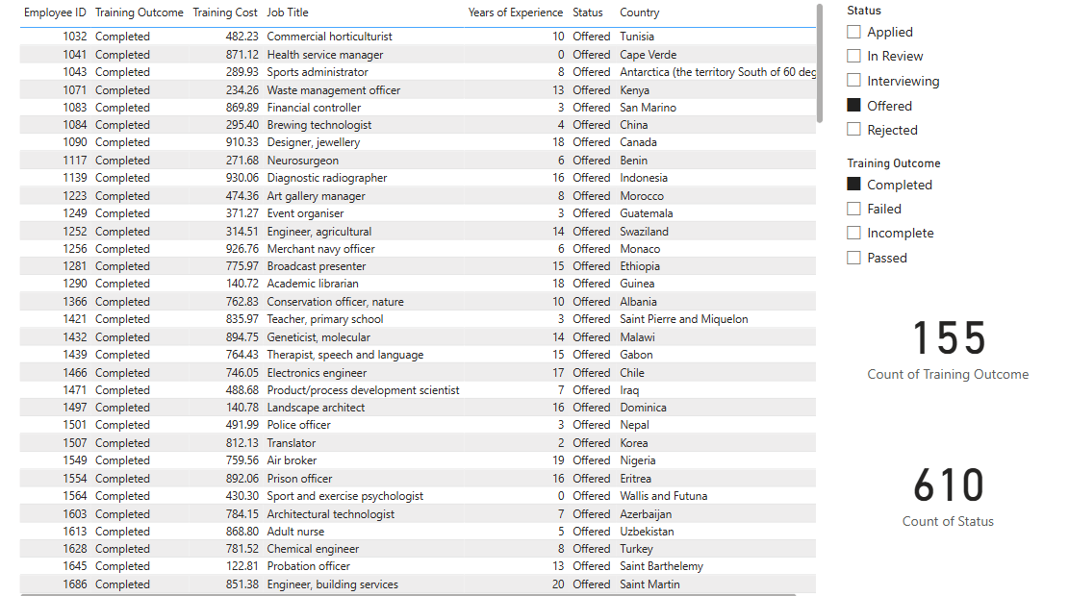
Relationship Analysis
The data provided having relation between Recruitment data, Employee Engagement and Training data. Used Slicer to filter the data with different data aspects to get result with relation data.
Used both slicers to get the results quickly which helps us to find the certain outcomes and status with combination.

Slide 21
Overall Key Findings and Final Thoughts
Key Findings:
Recruitment is strong, but improving conversion from offer to join could enhance results.
Employee engagement needs deeper strategies beyond satisfaction like recognition, growth paths, and a stronger sense of purpose.
Training is being used well, but we should keep focusing on quality, relevance, and alignment with what employees truly need.
No single factor drives engagement a mix of well-planned actions across all areas makes the real impact.
Final Thoughts:
This analysis really showed how every part of the employee journey matters from the way we hire, to how we keep people engaged, to how we help them grow.
It’s clear that no single factor drives success. Instead, it’s about creating balance combining smooth recruitment, meaningful engagement, and relevant learning opportunities.
The data gave us a better understanding of what’s working and where we can do more. Small improvements in communication, support, and development can go a long way in creating a better employee experience.
Moving forward, the goal is simple: keep listening to our people, keep learning from the data, and keep building a workplace where everyone can thrive.

Slide 22
References
MS Excel for Data Observation and Data Preparation.
Power BI for Dashboards Creation and visual creations.
Jupyter Notebook for Correlation Finding between the data.
AI tools for Suggestions and references.
Power Point for final Presentation.
Links:
Dashboards:
Recruitment Dashboard - Power BI
Employee Engagement Dashboard - Power BI
Training and Development Dashboard - Power BI
Co-relation Dashboard - Power BI
GitHub Link

Slide 23
Thank You

